Slide 1
Blood supply of brain
By
Dr.Ch.N.V.Bharath

Slide 2
Main arteries
Vertebro -basillar system
Internal carotid system

Slide 3
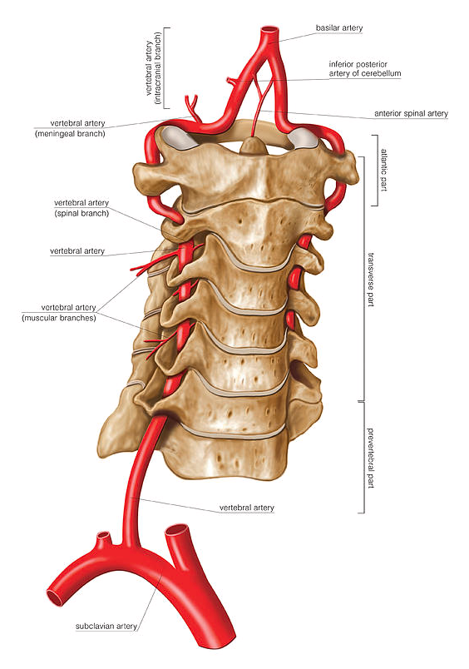
Vertebral artery
A branch of subclavian artery
Course - 4 parts
1st
2nd
3rd
4th

Slide 5
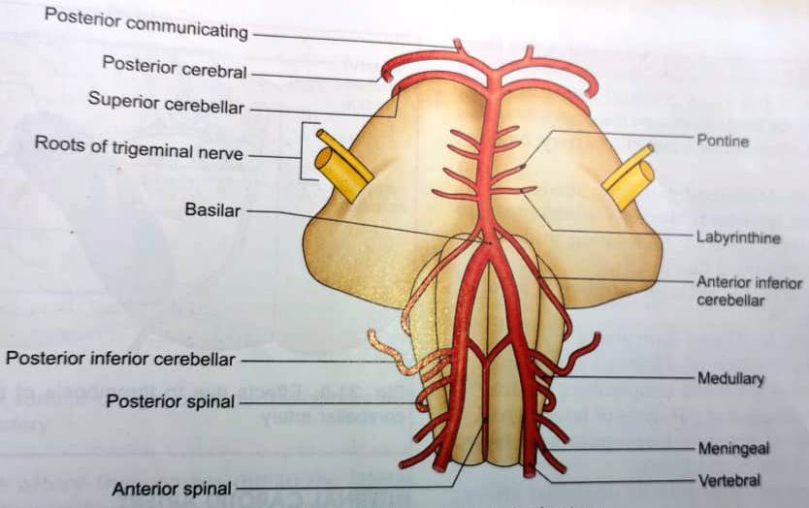
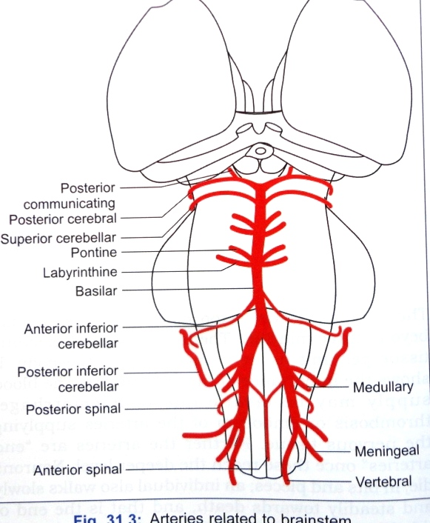
Vertebral artery
Meningeal
Posterior spinal
Posterior inferior cerebellar
Anterior spinal
Medullary

Slide 6
Basilar artery
Anterior inferior cerebellar
Labyrinthine
Pontine
Superior cerebellar
Posterior cerebral

Slide 7
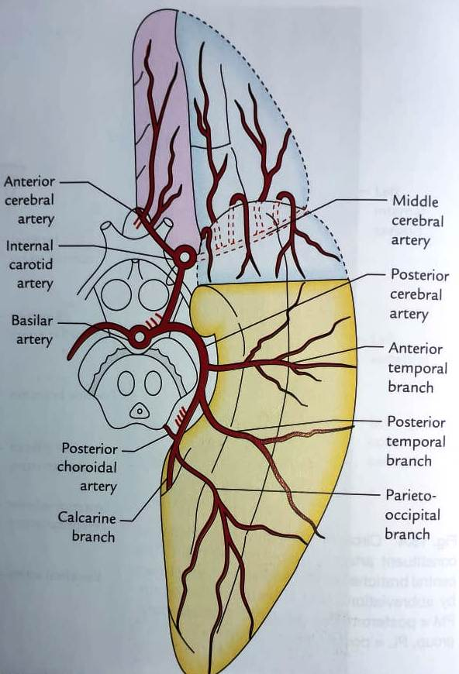
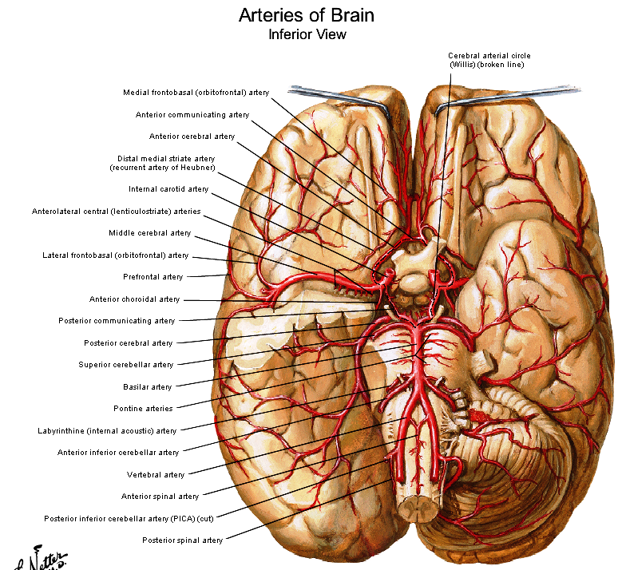
Posterior cerebral artery
Ant.temporal,
Post.temporal
parieto-occipital
calcarine

Slide 8
Internal carotid artery
Origin- From CCA at the level of upper border of thyroid cartilage

Slide 11
Terminal branches - Ant cerebral and middle cerebral

Slide 12
1.Posterior communicating artery
Runs backward to join PCA
Gives branches to hypophysis cerebri and hypothalamus

Slide 13
2. Anterior choroidal artery
Runs with optic tract
Enters inferior horn of LV thro choroid fissure
Supplies choroid plexus
Artery of cerebral thrombosis.

Slide 14
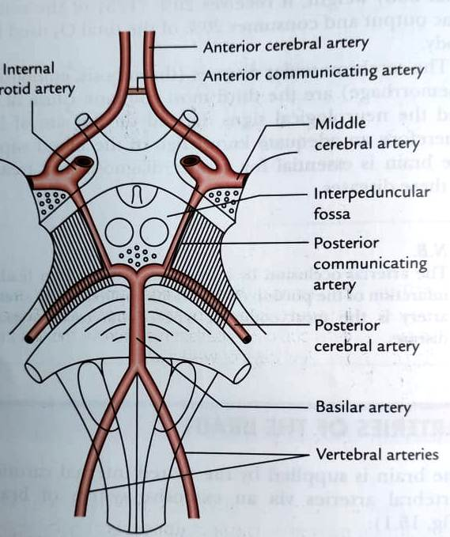
3.Anterior cerebral artery
Smaller terminal
Course – runs forward and medially.
Above the optic nerve– connected by ant. Communicating art.
Runs above the CC

Slide 15
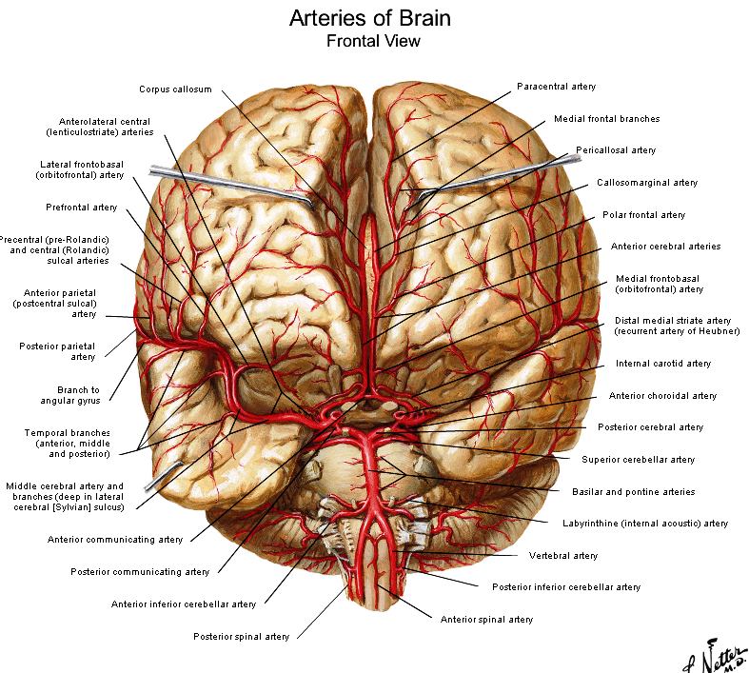
Anterior cerebral arteries

Slide 16
Orbital
Frontal
Parietal

Slide 17
4.Middle cerebral artery
Larger terminal
Runs laterally thro lateral sulcus.
Gives deep perforating brs

Slide 18
Temporal
Frontal
Parietal

Slide 19
5.Opthalmic artery

Slide 21
CIRCLE OF WILLIS
Circulus arteriosus
Location – Interpeduncular cistern
Shape – polygonal
Equalize the flow of blood
Collateral circulation

Slide 22
Formation

Slide 23
Central branches
Six groups
Anteromedial
Right and left anterolateral
Posteromedial
Right and left Posterolateral

Slide 24
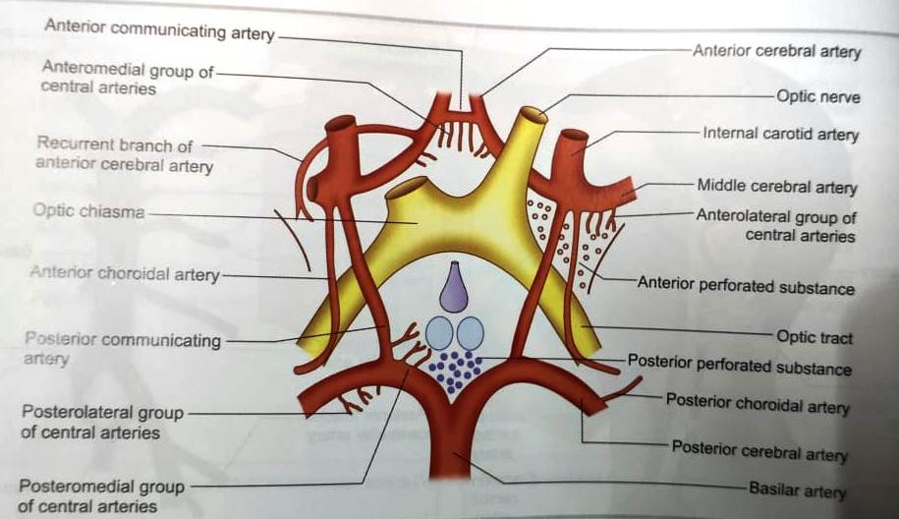
Central branches
1. AM group from ant com, ACA and ICA
Recurrent branch of ACA/Artery of HEUBNER
Thrombosis of this art leads to contralateral upper monoplegia

Slide 25
2. AL group from MCA (striate brs)
Charcot’s artery of cerebral hemorrhage.
3.posteromedial group from PCA and PCA
Also called thalamo perforators
4.PL group from PCA
Also called thalamogeniculate

Slide 26
Branching pattern
Types of branches from ACA,MCA AND PCA
Central
Cortical
Choroidal

Slide 27
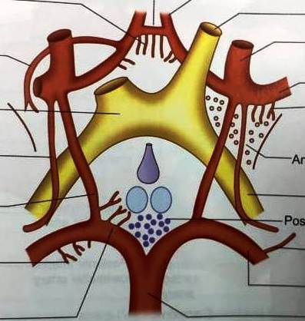
Central
thin walled , slender perforating
End arteries
Anteromedial
Right and left anterolateral
Posteromedial
Right and left Posterolateral

Slide 28
Cortical
End arteries
2 types
1. Short
2. Long

Slide 29
Orbital
Frontal
Parietal
Anterior cerebral artery

Slide 30
Orbital
Temporal
Frontal
Parietal
Middle cerebral artery

Slide 31
Posterior cerebral artery
Ant.temporal,
Post.temporal
parieto-occipital
calcarine

Slide 32
Choroidal Anterior choroidal artery
Runs with optic tract
Enters inferior horn of LV thro choroid fissure
Supplies choroid plexus
Artery of cerebral thrombosis.

Slide 33
Posterior choroidal artery
Choroid plexus of 3rd ventricle and lateral ventricles.

Slide 35
Supply of different surfaces
Superolateral surface
MCA (2/3)
ACA
PCA

Slide 36
Medial surface
ACA (2/3)
MCA
PCA

Slide 37
Inferior surface
PCA
MCA
ACA

Slide 38
Cortical branches

Slide 39
Cortical and central branches do not anastomose.
No anastomosis inside the brain tissue.

Slide 40
Venous drainage
Devoid of muscle
No valves
Veins of cerebrum – Superficial and deep veins

Slide 41
Venous drainage
Superior cerebral veins
Inferior cerebral veins
Superficial middle cerebral vein
Superior anastomotic vein
Inferior anastomotic vein

Slide 42
Deep middle cerebral vein
Anterior cerebral vein

Slide 43
Deep veins
Internal cerebral veins

Slide 44
Great cerebral vein (Galen)
Basal vein

Slide 45
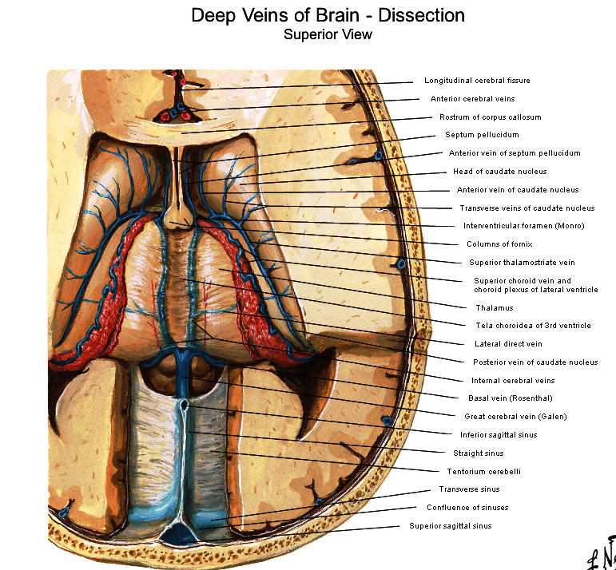
Thalamo striate vein
Choroid vein
Internal cerebral vein
Great cerebral vein

Slide 47
CAROTID ANGIOGRAM
Anterior view

Slide 48
CAROTID ANGIOGRAM
Lateral view

Slide 49
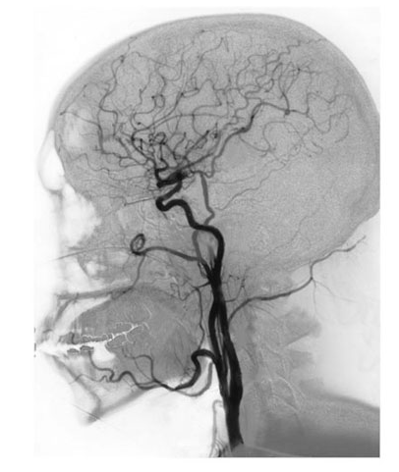
CAROTID ANGIOGRAM

Slide 50
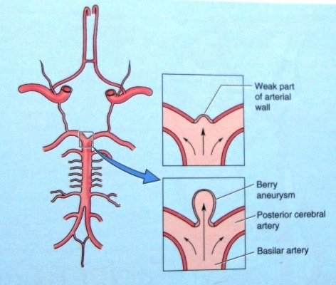
ANEURYSM

